Slide 1
Emergency Device Management System
Presentation

Slide 2
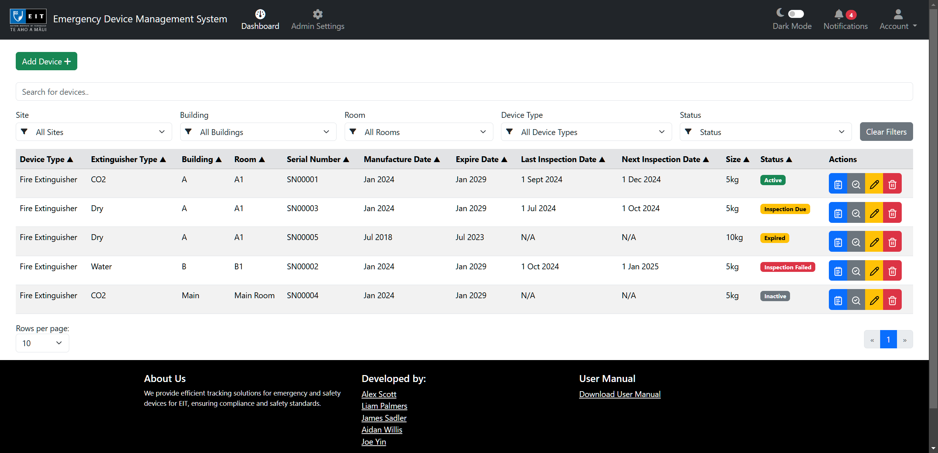
Application Overview
This web app helps manage and track emergency devices, primarily fire extinguishers, across campuses. It is cross-platform and accessible from any device with a web browser.

Slide 3
Application Features
Key Features:
Authentication: Create an account, log in, and reset your password.
Manage Devices: View, add, edit, and delete devices.
Interactive and static site maps: View and interact with site maps.
Inspect Fire extinguishers: View and add inspections.
Filter Functionality: Filter devices by site, building, room, type, or status.
Search Functionality: Search for devices using the search box.
Role-Based Access: Admins manage devices; users have limited access.
Automated Alerts: Notifications for device expirations and maintenance.
Admin Controls: View, add, edit, and delete, users, sites, buildings, rooms, and device types.

Slide 4
Prototype 1 - Completed features
Admin Settings:
View All User Accounts
Update User Account details such as username, email, role, and password
Delete User Account
View All Sites
Add a Site with a site name, site address, and an optional site map image
Update a Site
Delete a Site
View all Device Types
Add a Device Type with a Device type name
Update a Device Type
Delete a Device Type
Authentication:
Create an account
Login
Forgot password
Dashboard:
View All Emergency Devices
Add an Emergency Device
Update an Emergency Device
Delete an Emergency Device
View Site Map
Filter by building using map
Filter by site using dropdown

Slide 5
Prototype 2 – Completed features
Dashboard:
Filter devices by building
Filter devices by room
Filter devices by Device Type
Filter devices by Status
Inspection:
Add a Fire extinguisher inspection
View All inspections for a Fire extinguisher
Notifications:
View all device inspection and expiry notifications
Clear notifications

Slide 6
Final App – Will do features
Dashboard:
Sort devices by their properties in ascending or descending order.

Slide 7
Project Status
Prototype 1 release: 06/10/24 – Complete
Prototype 2 release: 27/10/24 – Complete
Final Application release: 10/11/24 – In Development/Deployment

Slide 8
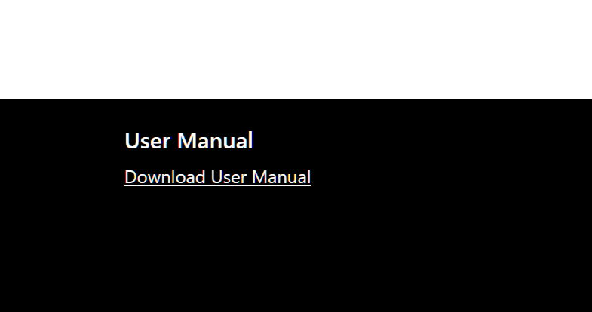
User Guide Development Plan
We are creating a PDF that outlines the app's features, usage instructions, and installation steps.
A link to view and download the PDF will be provided in the app's footer

Slide 9
Deployment Details
The app is hosted using Google Cloud Run for the Go API and Google Cloud SQL for the database.
The application currently uses a free tier; however, more research/maintenance may be required long-term to keep it running.
I’ve created the Google Account for the project, which can be handed over.
(note I had to add my debit card as a payment method to access the free tier, this needs to be updated before the final handover!)

Slide 10
App Live Demo
https://edms-696265273108.australia-southeast2.run.app/

